Slide 1
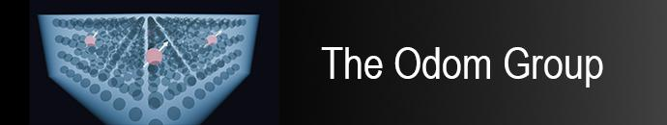



A Dual-Species Beam Source
for Doped Cryogenic Crystal Growth
Isaac K. Cross
04/14/2026 CFP Pre-talk

Slide 2
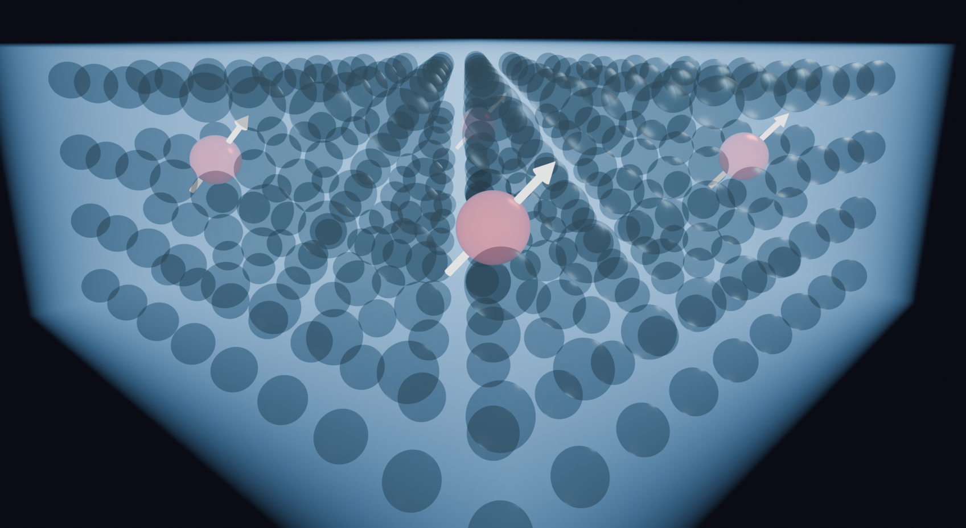
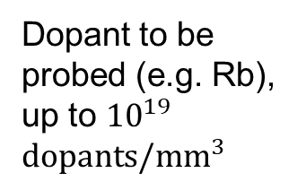
Doped Cryogenic Crystal
Inert Cryogenic Noble Gas Crystal Host
(e.g. Argon)
Dopant to be probed (e.g. Rb), up to ${10}^{19}$ $dopants/mm^{3}$
*Not to scale

Slide 3
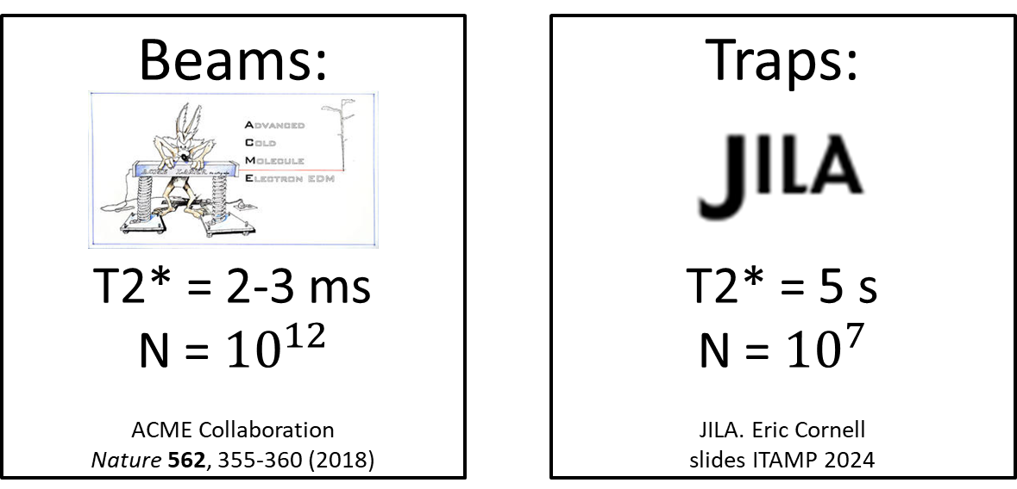
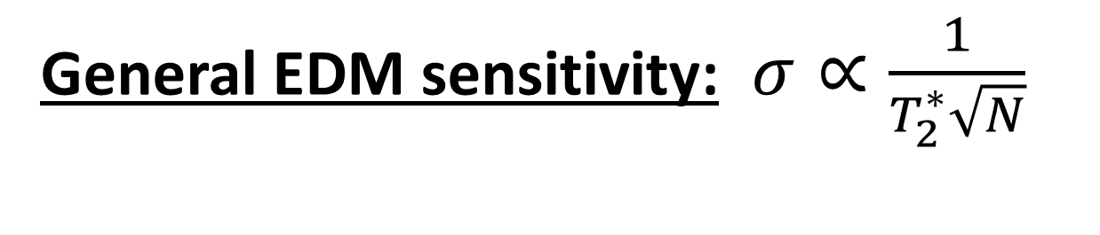
Leading EDM Platforms

Slide 4
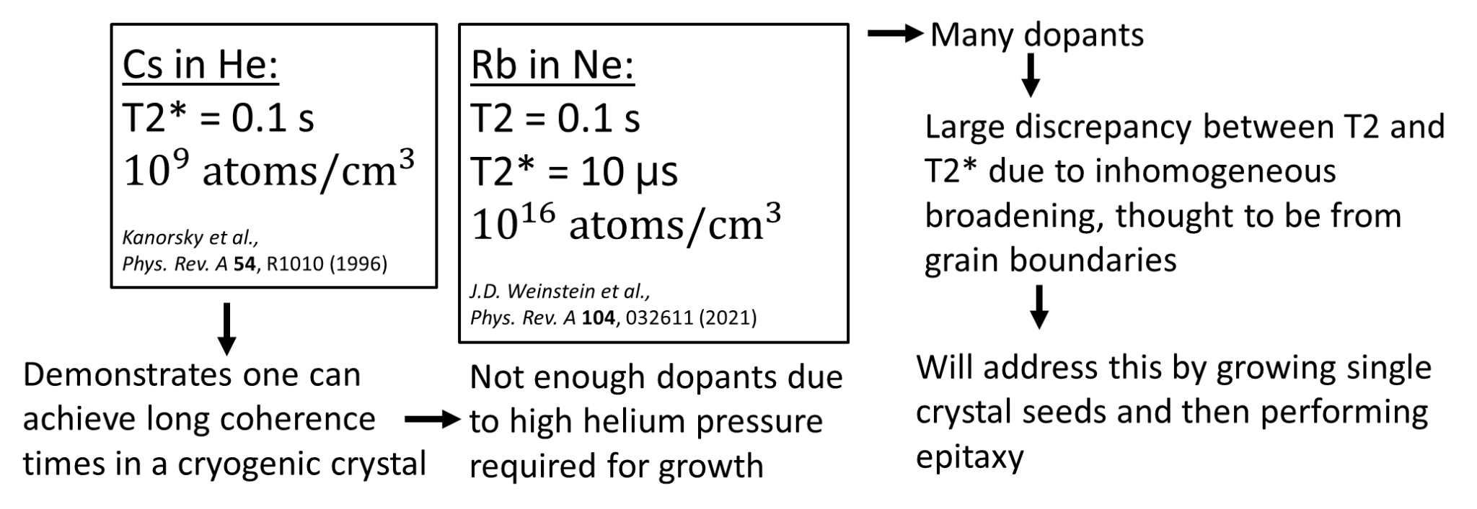
Leading EDM Platforms
Doped Crystals?
Notes:
such that a doped cryocrystal could in principle provide in seconds the same uncertainty obtained by ACME in their 350-hour data set. Said a different way, the doped crystal would have over 1013 molecules in a 1 mm3 volume, which can be compared with the few hundred thousand molecules in the ACME-II beam at any given time.

Slide 5
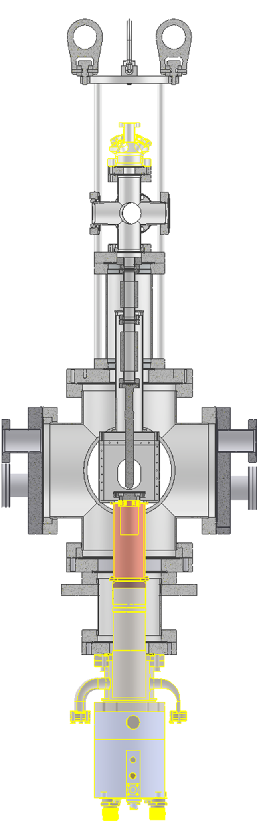
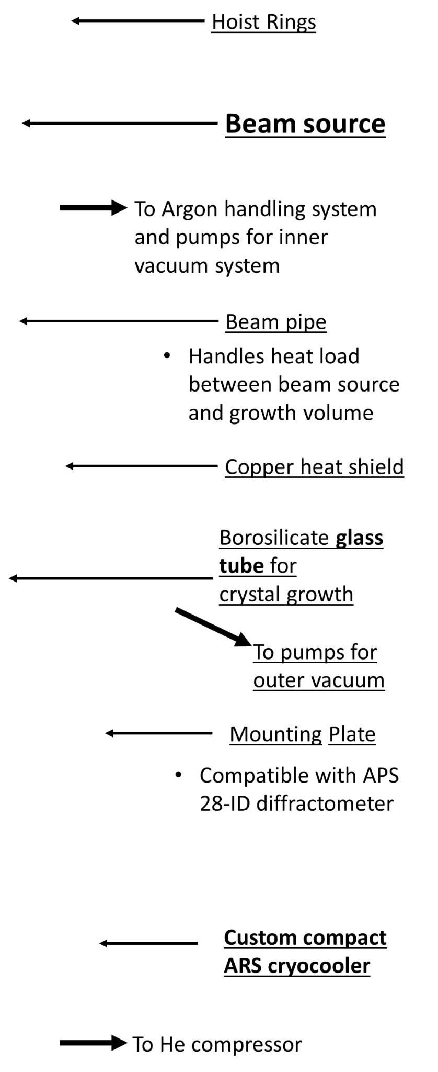
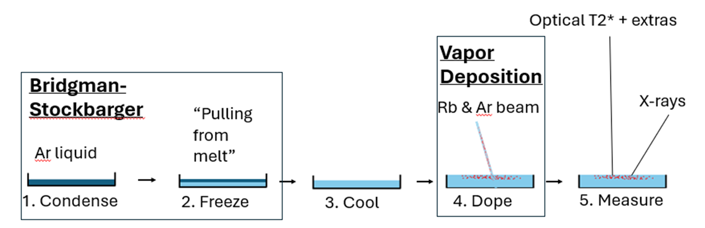
Our Growth Method
Notes:
Expect to grow slower/ UHV

Slide 6
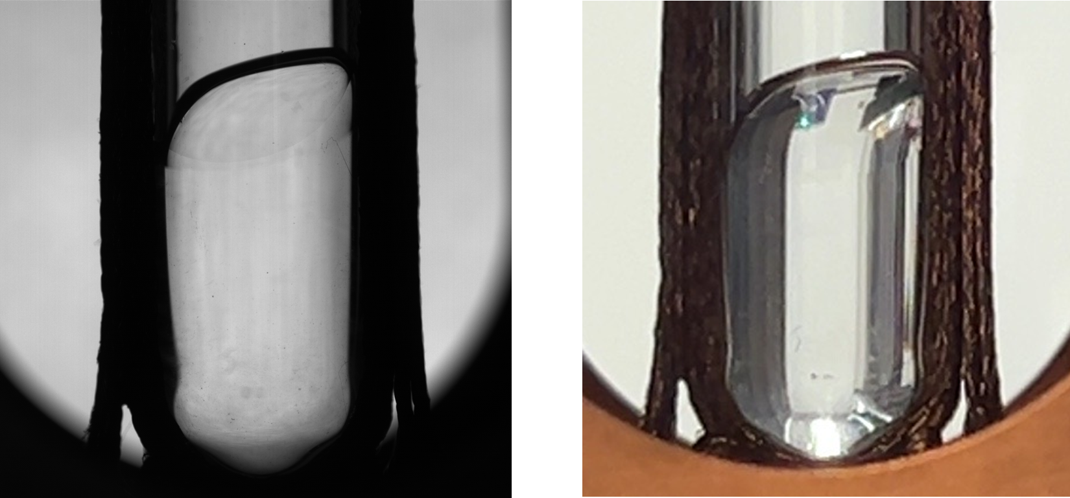
Our Growth Method
Ar Crystals!
Notes:
Expect to grow slower/ UHV

Slide 7
Our Growth Method
Ar Crystals!
Notes:
Expect to grow slower/ UHV

Slide 8
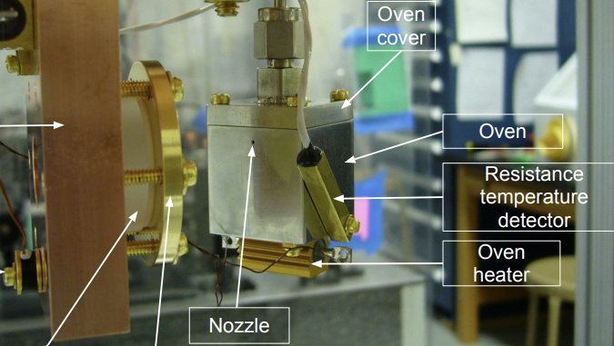
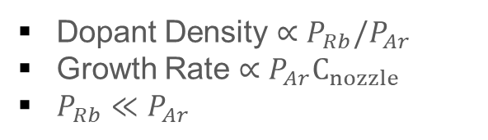
Beam Source Constraints
Ar
Rb
Dopant Density $∝P_{Rb}/P_{Ar}$
Growth Rate $∝P_{Ar}C_{nozzle}$
$P_{Rb}≪P_{Ar}$
Regmi, 2013, M.S. thesis, University of Nevada, Reno.
Weinstein Group
Notes:
Also want slower growth rates than others therefore lower Ar Pressure and therefore even lower Rb pressure….

Slide 9
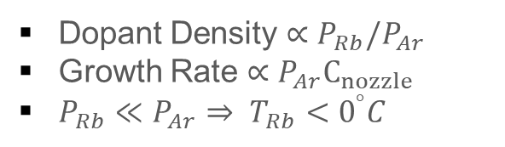
Beam Source Constraints
Ar
Rb
Dopant Density $∝P_{Rb}/P_{Ar}$
Growth Rate $∝P_{Ar}C_{nozzle}$
$P_{Rb}≪P_{Ar}⇒ T_{Rb}<0^{°}C$
Regmi, 2013, M.S. thesis, University of Nevada, Reno.
Weinstein Group
Notes:
Also want slower growth rates than others therefore lower Ar Pressure and therefore even lower Rb pressure….

Slide 10

Beam Source Constraints
“Mixing Chamber”
Ar
Rb
“Rb Reservoir”
$P_{RbMc}∝P_{RbRs}\frac{C_{V}}{C_{V}+C_{N}}$
Regmi, 2013, M.S. thesis, University of Nevada, Reno.
Weinstein Group
Notes:
Check this shit plz

Slide 11
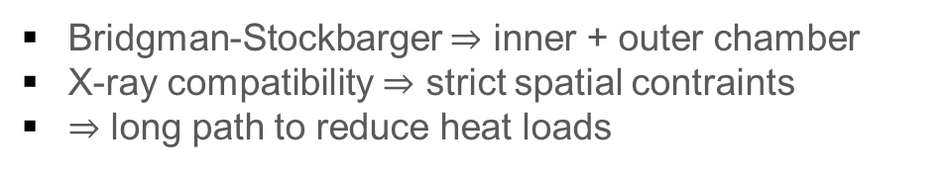
Beam Source Constraints
Ar
~1 cm
~0.5 m
Rb
Bridgman-Stockbarger $⇒$ inner + outer chamber
X-ray compatibility $⇒$ strict spatial contraints
$⇒$ long path to reduce heat loads
Notes:
Make it more clear how bridgman-stockbarger forces these connections and its a mechnical constraint.

Slide 12
Beam Source Constraints
Collimating Nozzle
Ar
~1 cm
~0.5 m
Rb
Need large Ar flux
Narrow divergence
Notes:
Be prepared for why not just increase Ar and Rb high enough and let it fly everywhere.
Think about Neon, gets very expensive….

Slide 13
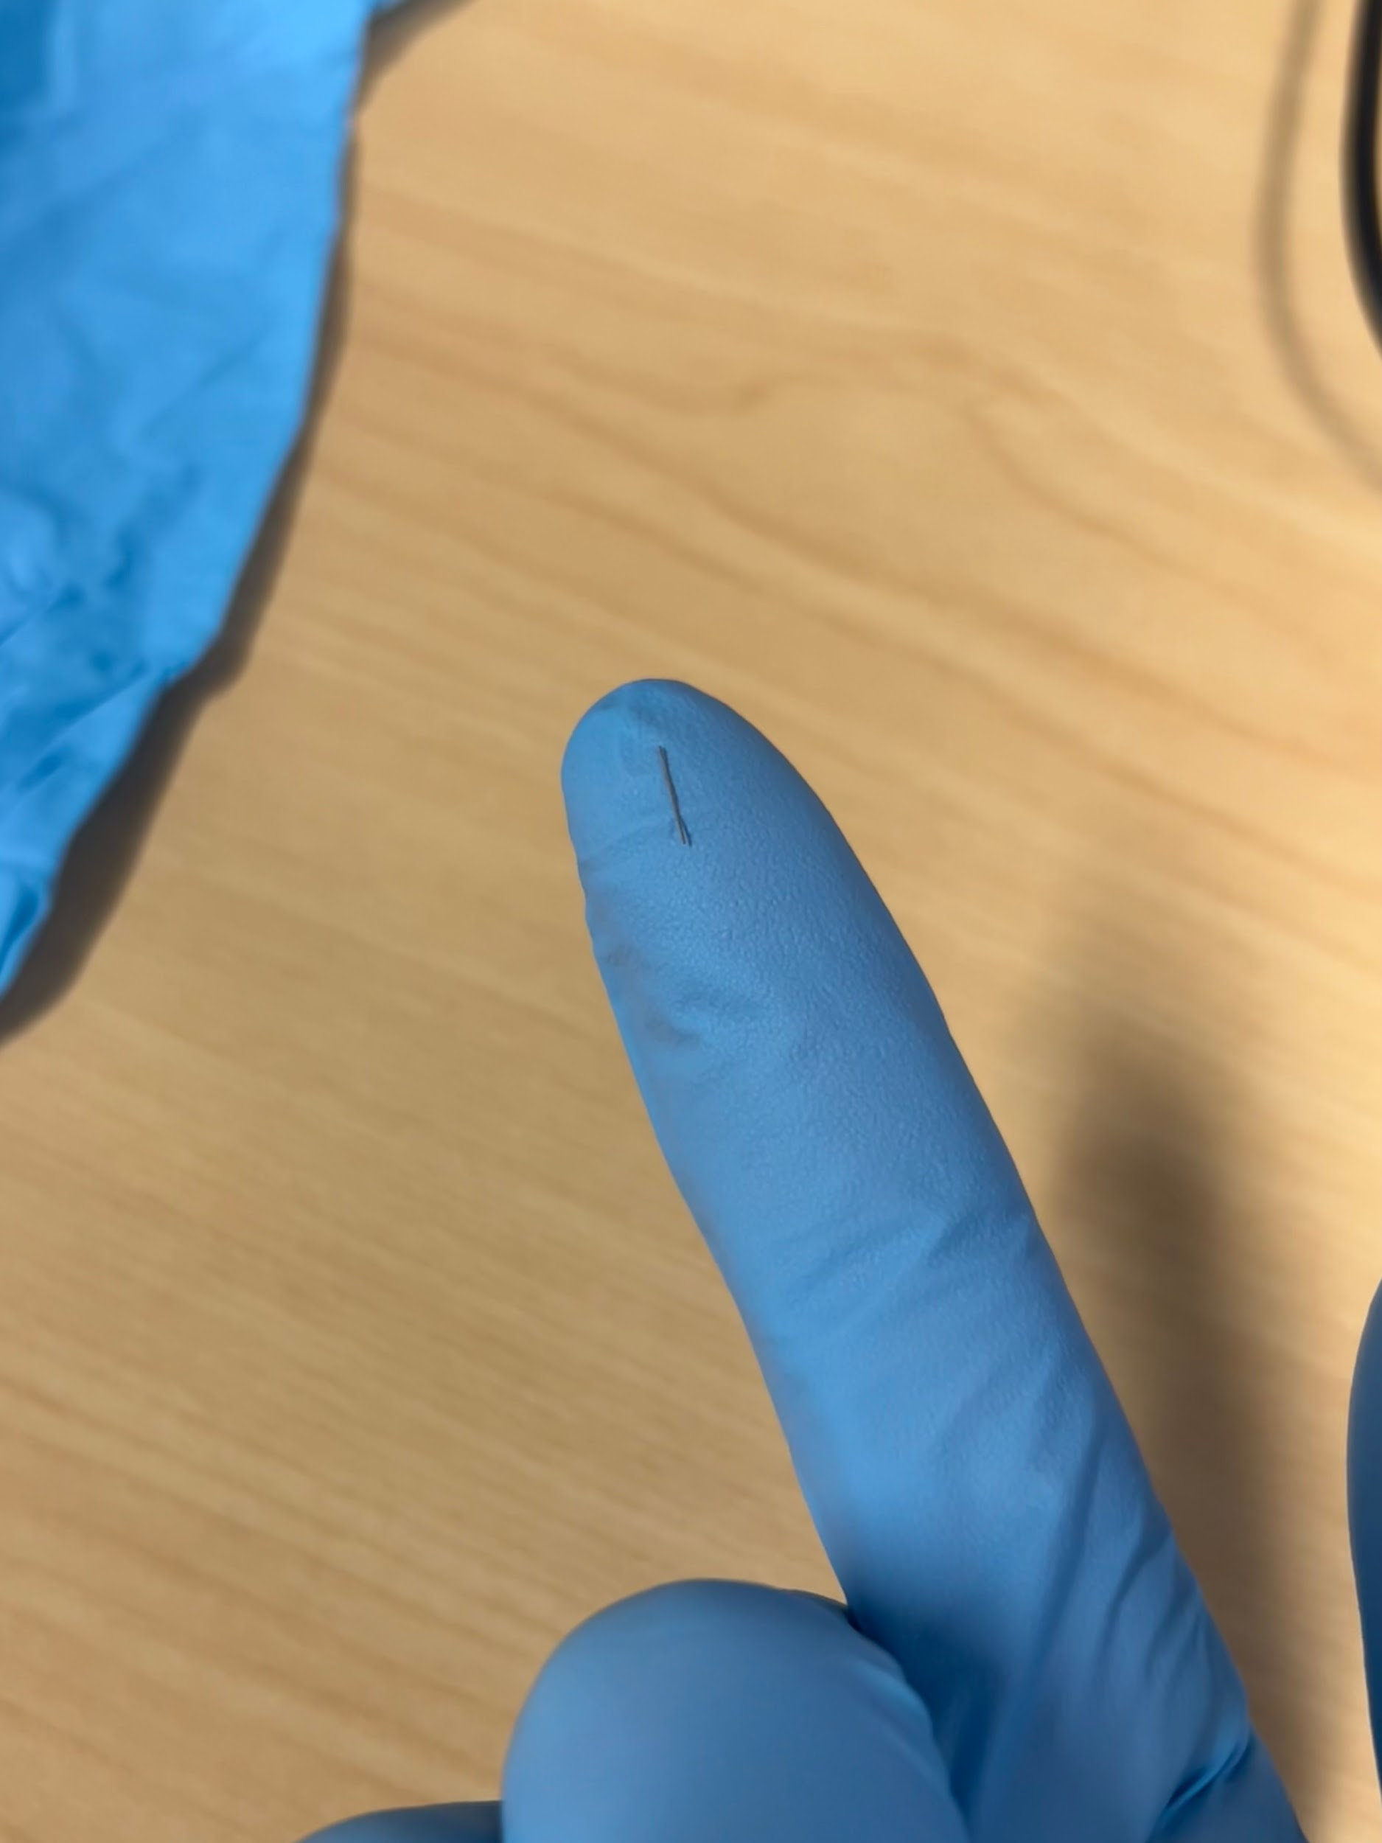
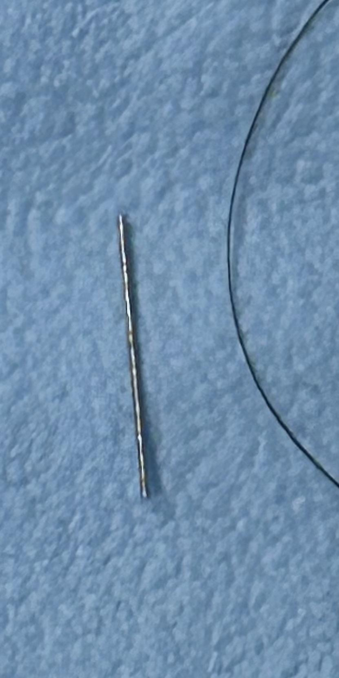
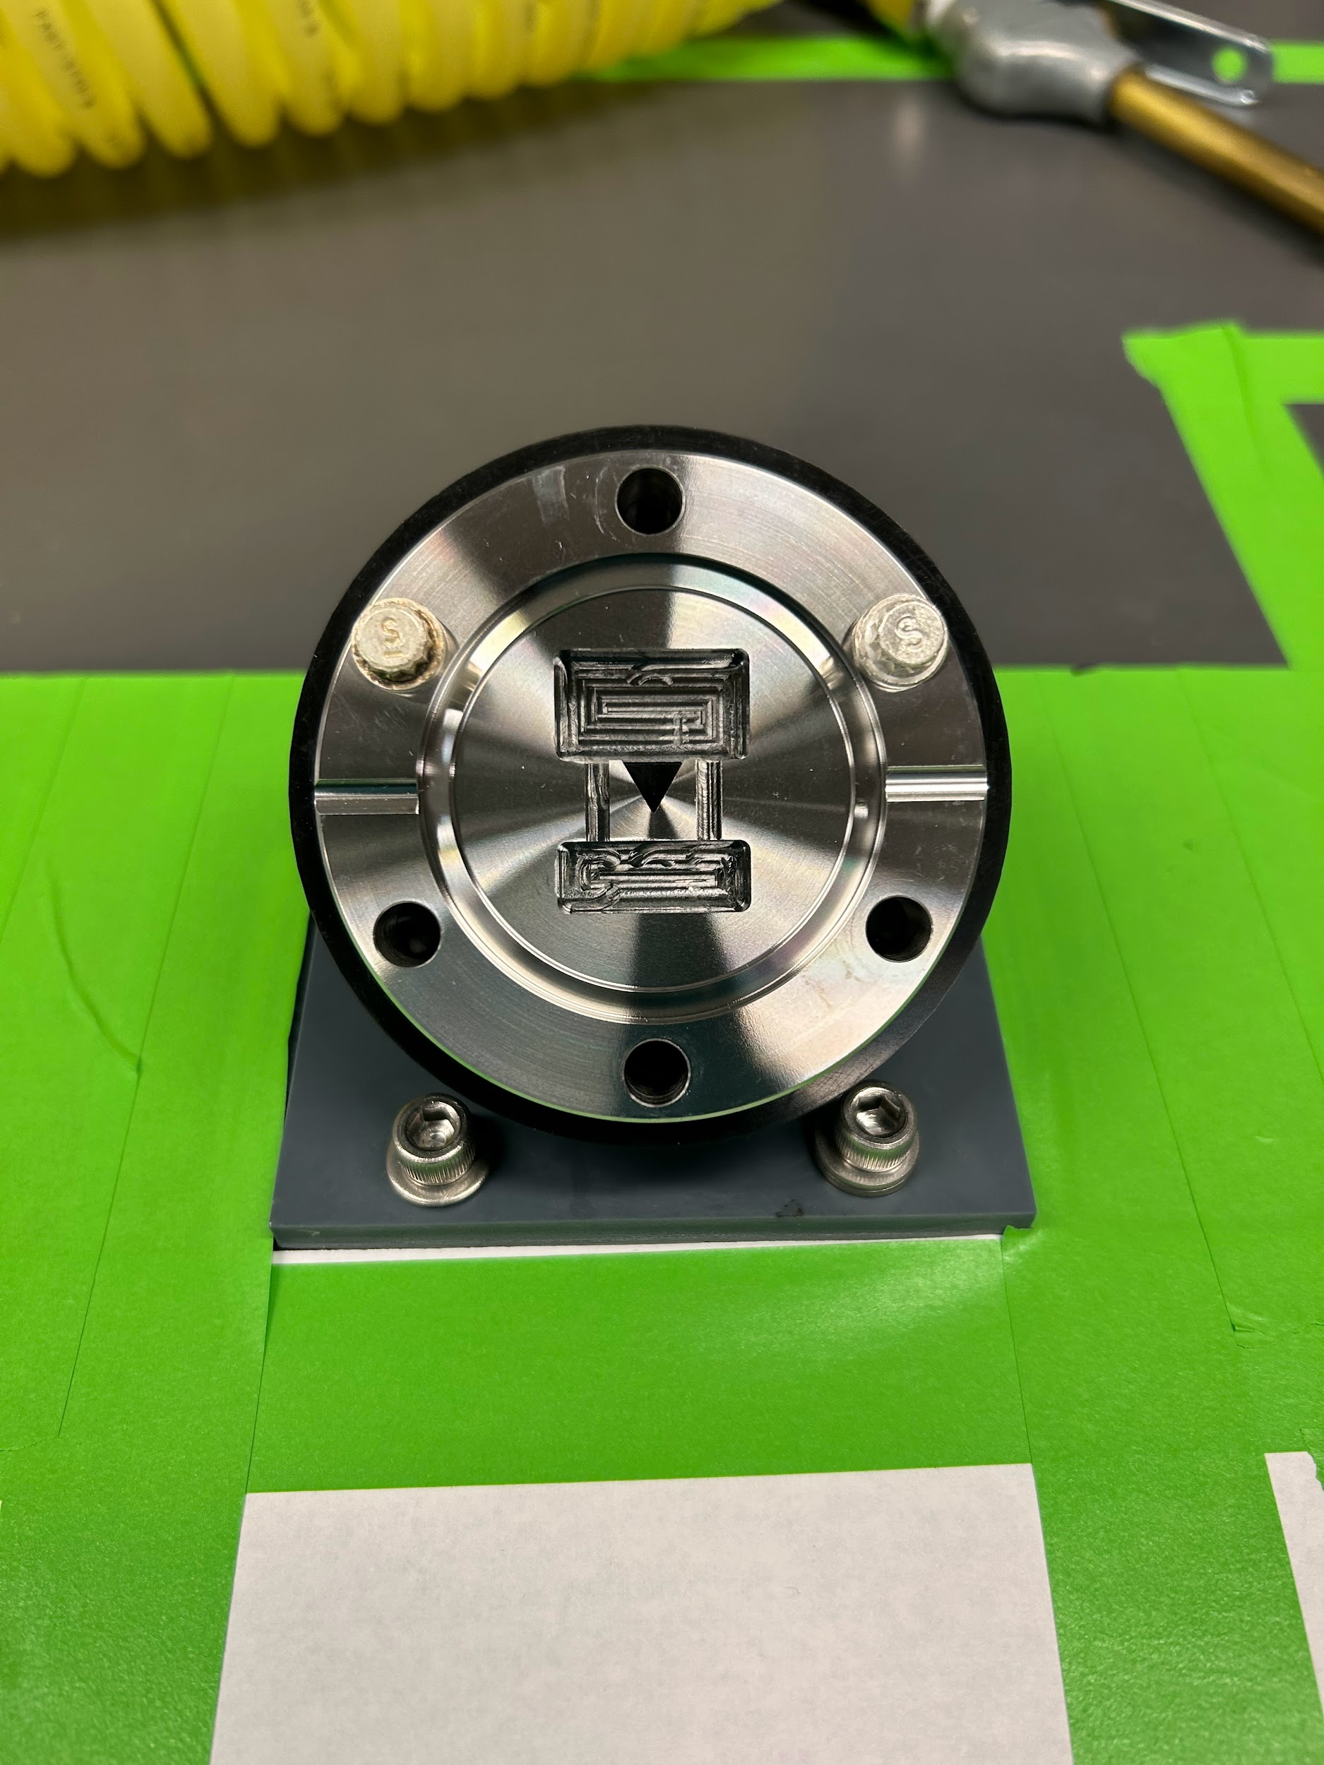
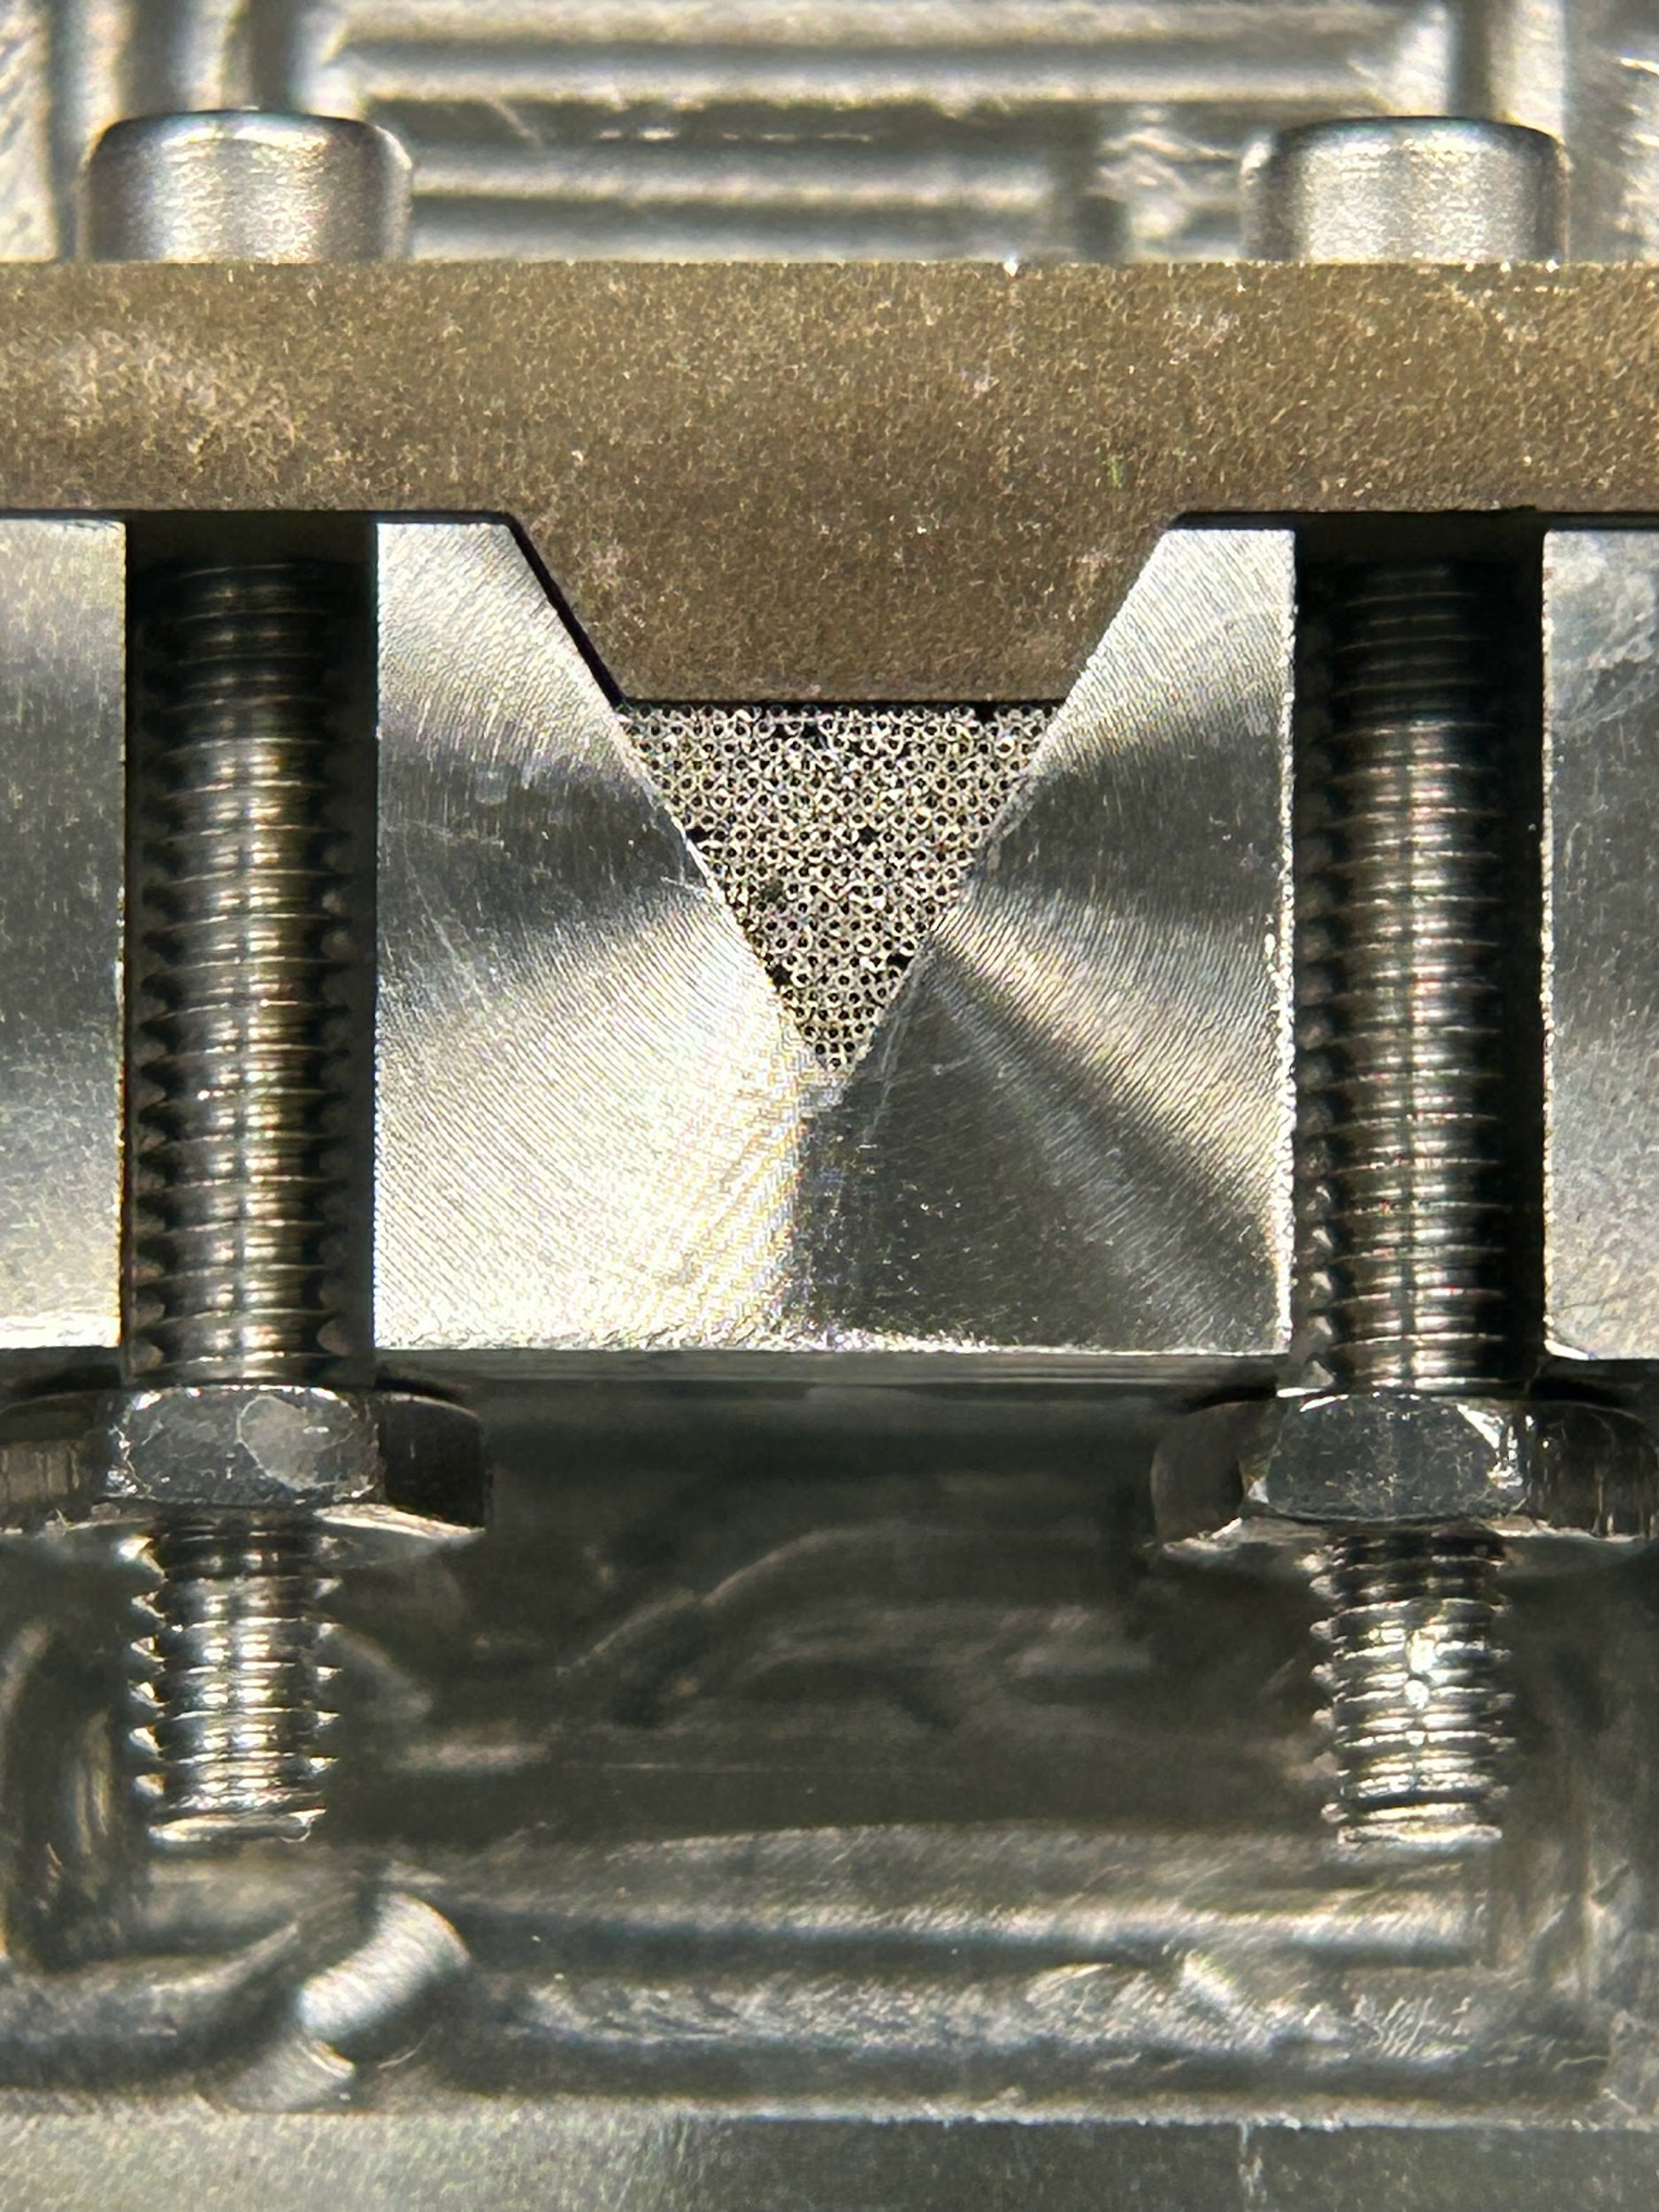
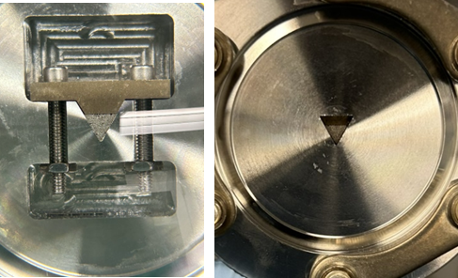
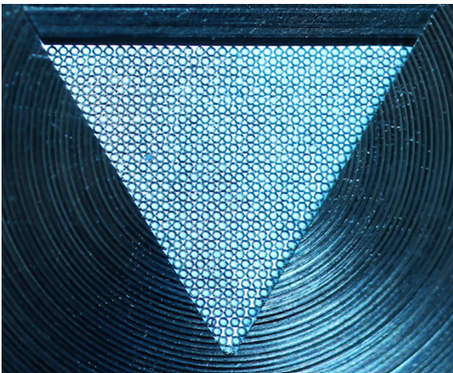
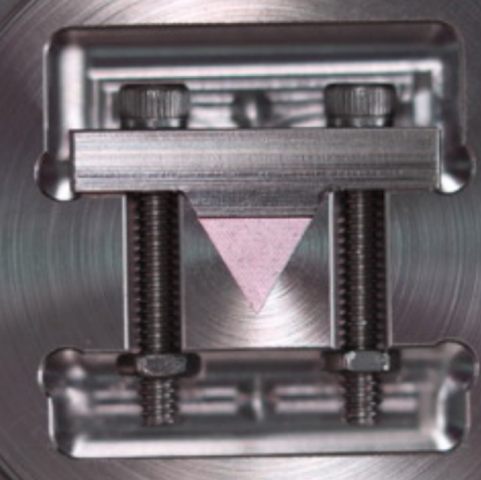
Microcapillary Nozzle Array
231, 100 µm ID, ~0.8 cm length microcapillaries
Wire EDM cut 5ft microcapillary from MicroGroup
Wire EDM cut 2.75” CF flange
hair for reference
Assembly Setup
Oven Side
Growth Chamber Side
Original Design:
R. Senaratne et al., Rev. Sci. Instrum. 86, 023105 (2015).

Slide 14
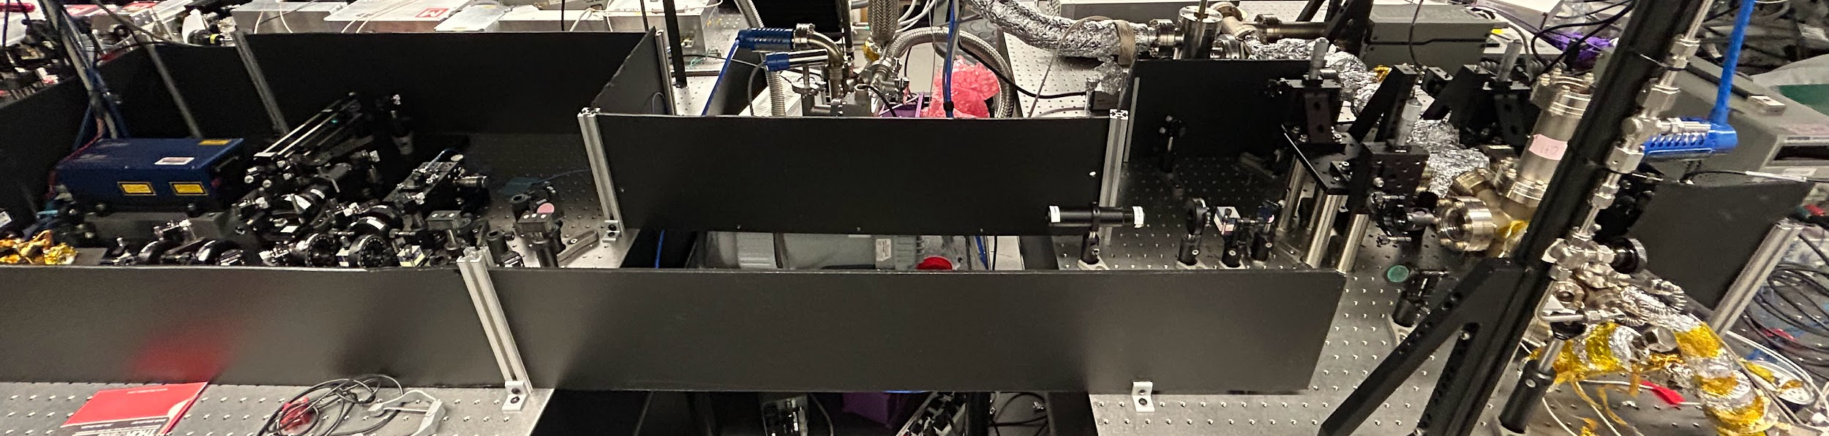
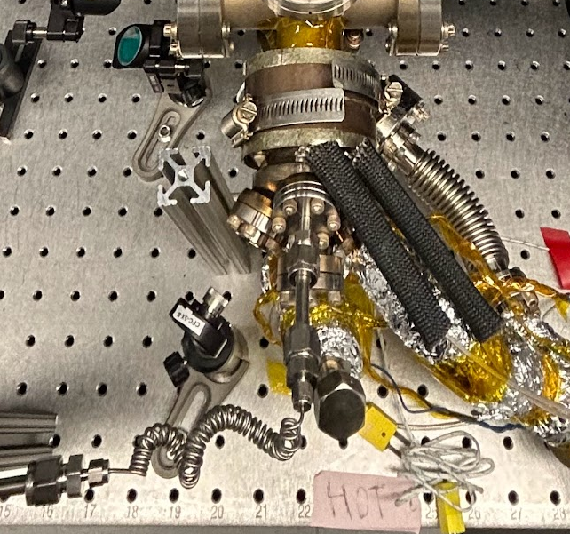
Characterizing Beam Source
Nozzle
Rb Reservoir
Ar Line

Slide 15
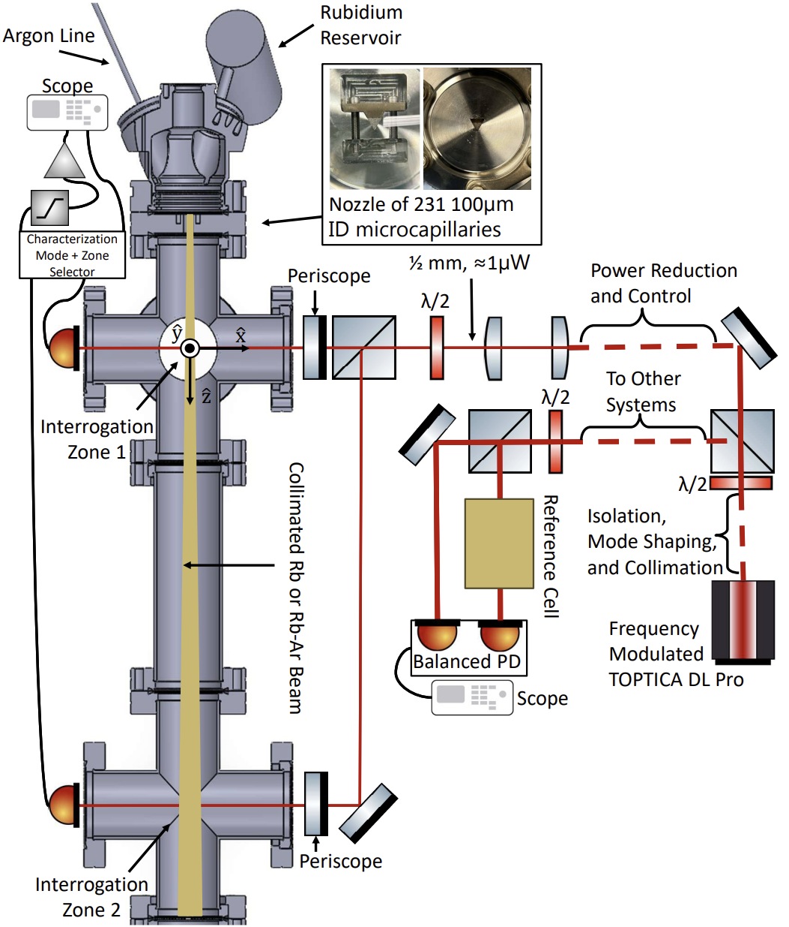
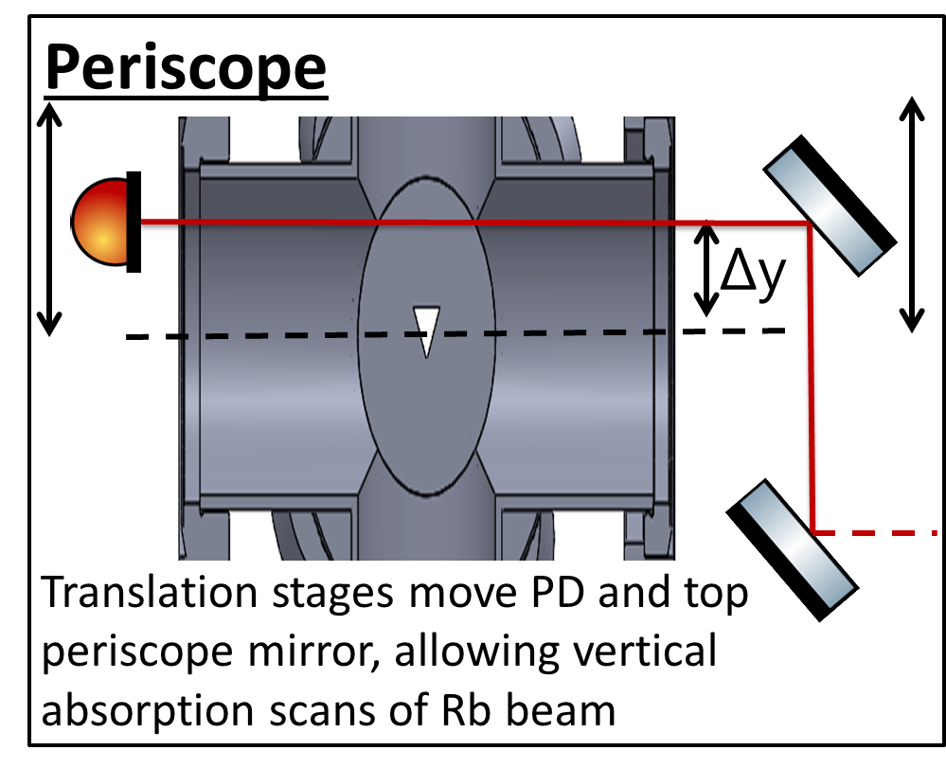
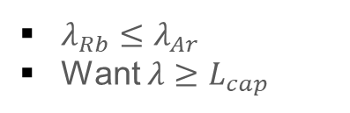
Characterizing Beam Source
$λ_{Rb}≤λ_{Ar}$
Want $λ≥L_{cap}$

Slide 16
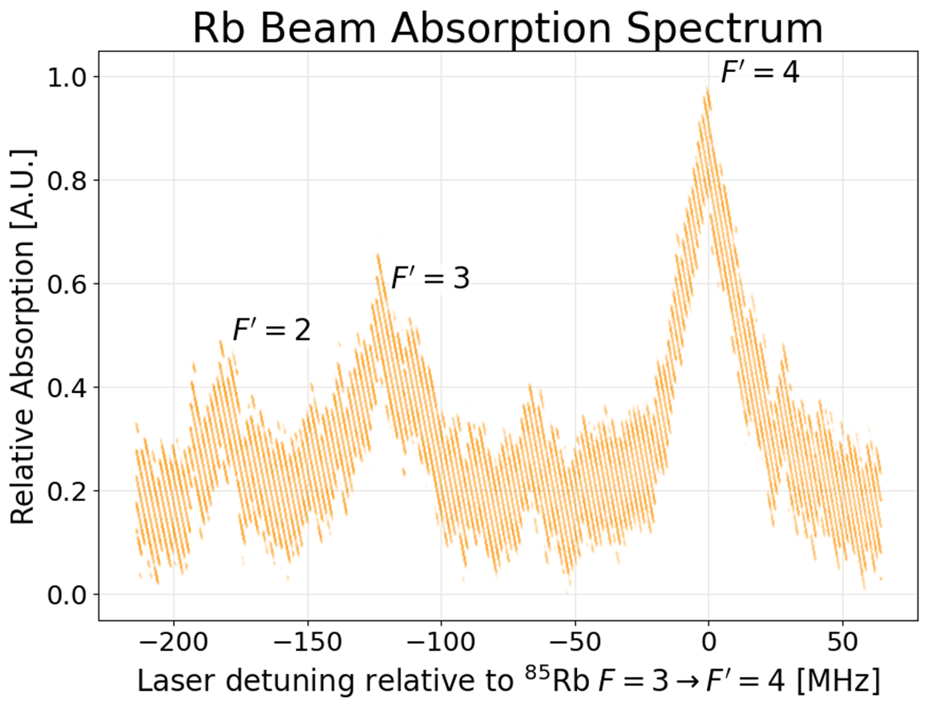
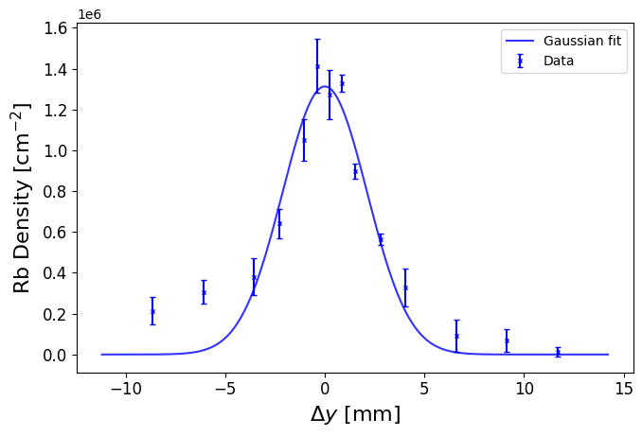
Characterizing Beam Source
Notes:
Add line about sensitivity (acme stats) and time to grow crystal

Slide 17
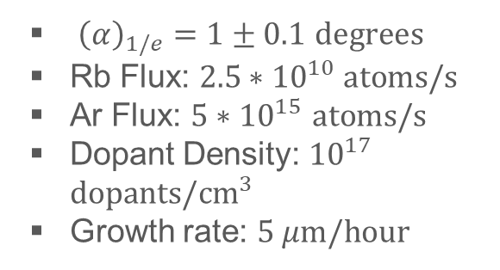
Characterizing Beam Source
${\left(α\right)}_{1/e}=1±0.1$ $degrees$
Rb Flux: $2.5∗{10}^{10} atoms/s$
Ar Flux: $5∗{10}^{15}$ $atoms/s$
Dopant Density: ${10}^{17}$ $dopants/{cm}^{3}$
Growth rate: $5 μm/hour$
Notes:
Add line about sensitivity (acme stats) and time to grow crystal

Slide 18
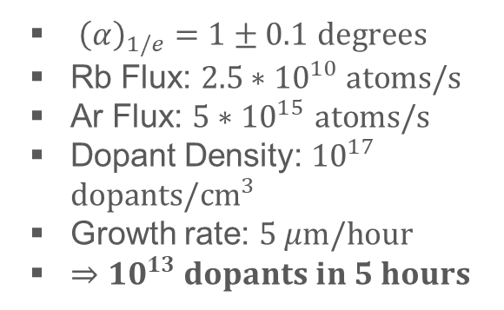
Characterizing Beam Source
${\left(α\right)}_{1/e}=1±0.1$ $degrees$
Rb Flux: $2.5∗{10}^{10} atoms/s$
Ar Flux: $5∗{10}^{15}$ $atoms/s$
Dopant Density: ${10}^{17}$ $dopants/{cm}^{3}$
Growth rate: $5 μm/hour$
$⇒{10}^{13} dopants in 5 hours$
Notes:
Add line about sensitivity (acme stats) and time to grow crystal

Slide 19
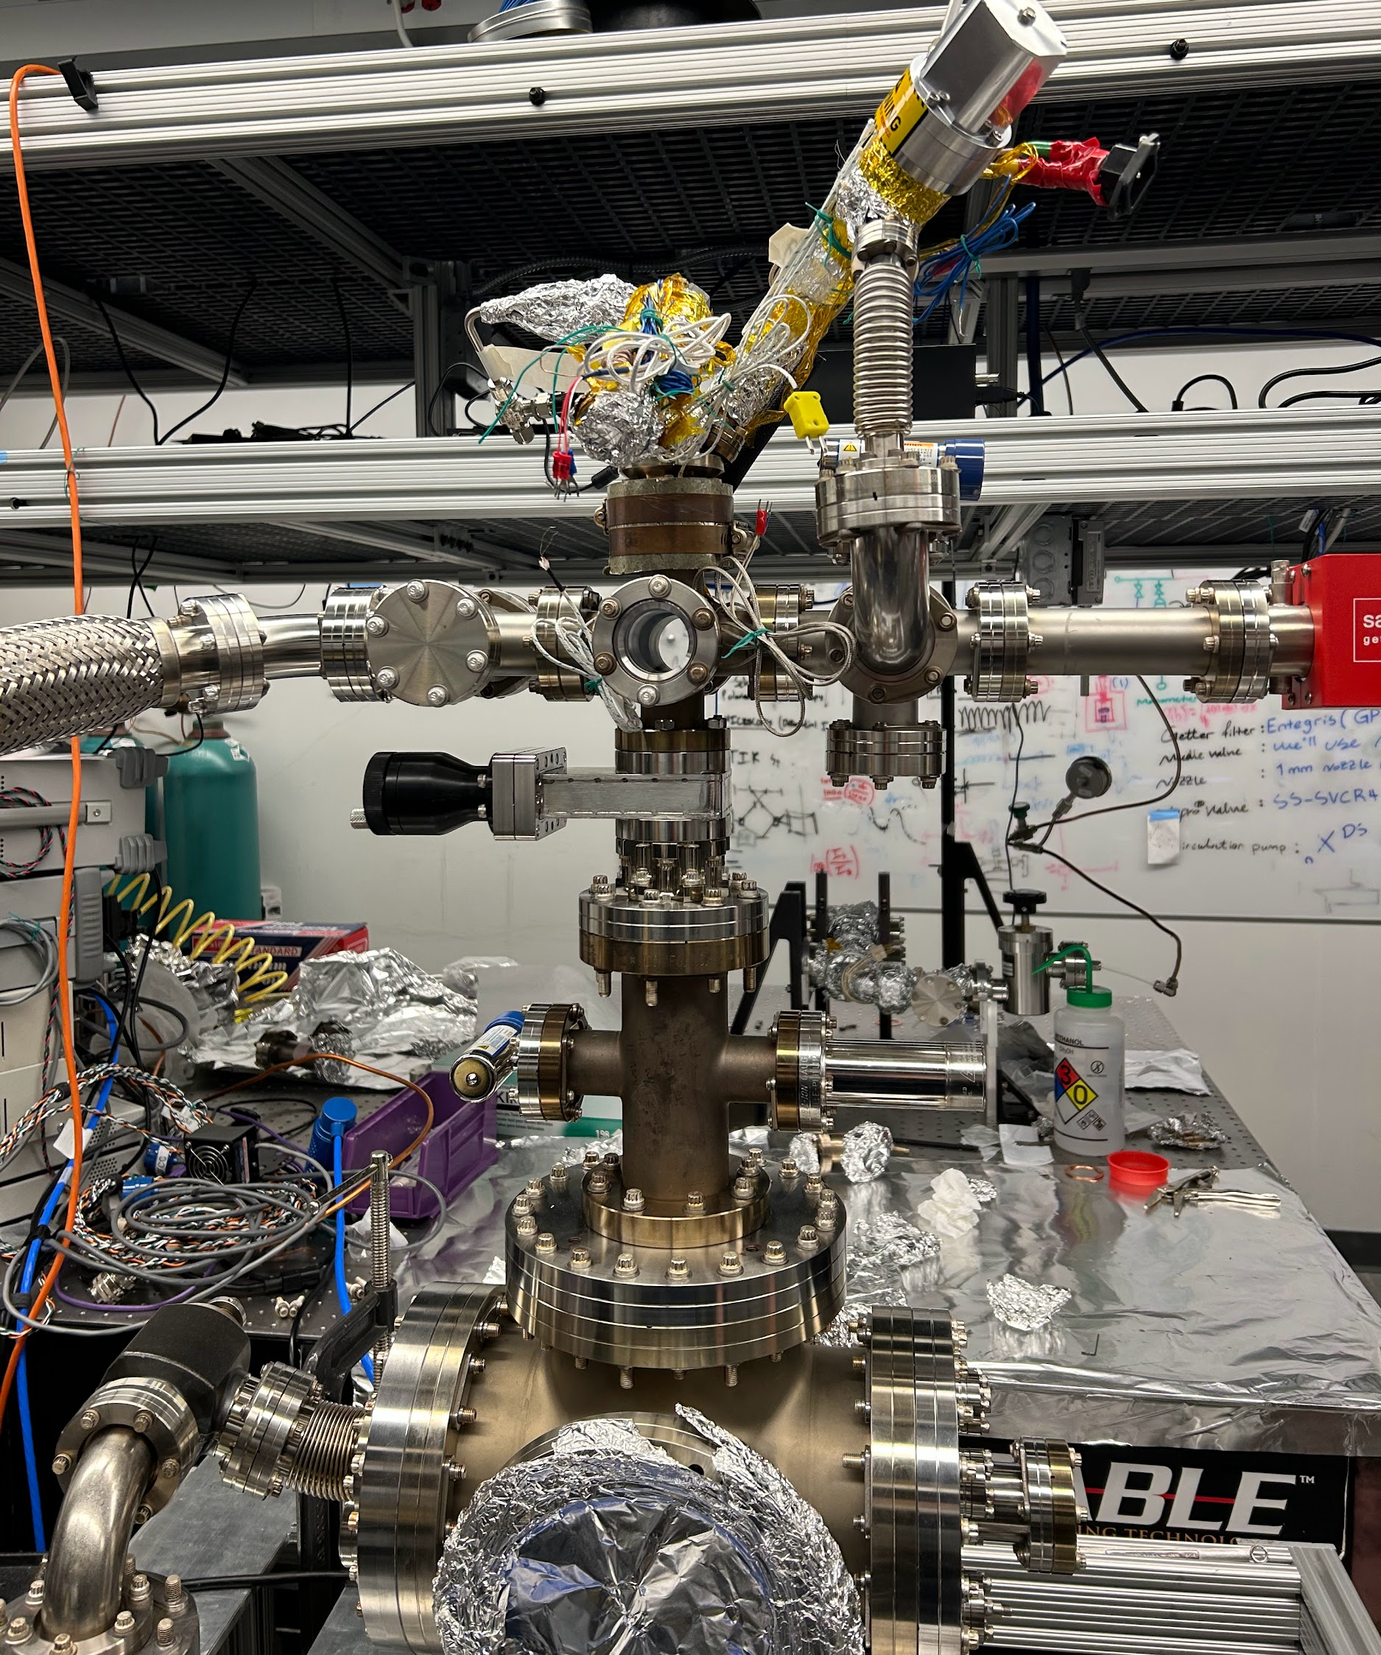
Next Steps
Grow Doped Crystals!!
Measure crystal properties to check beam characterization
  Growth Rate/Dopant Density can be directly measured
Explore larger parameter space

Slide 20




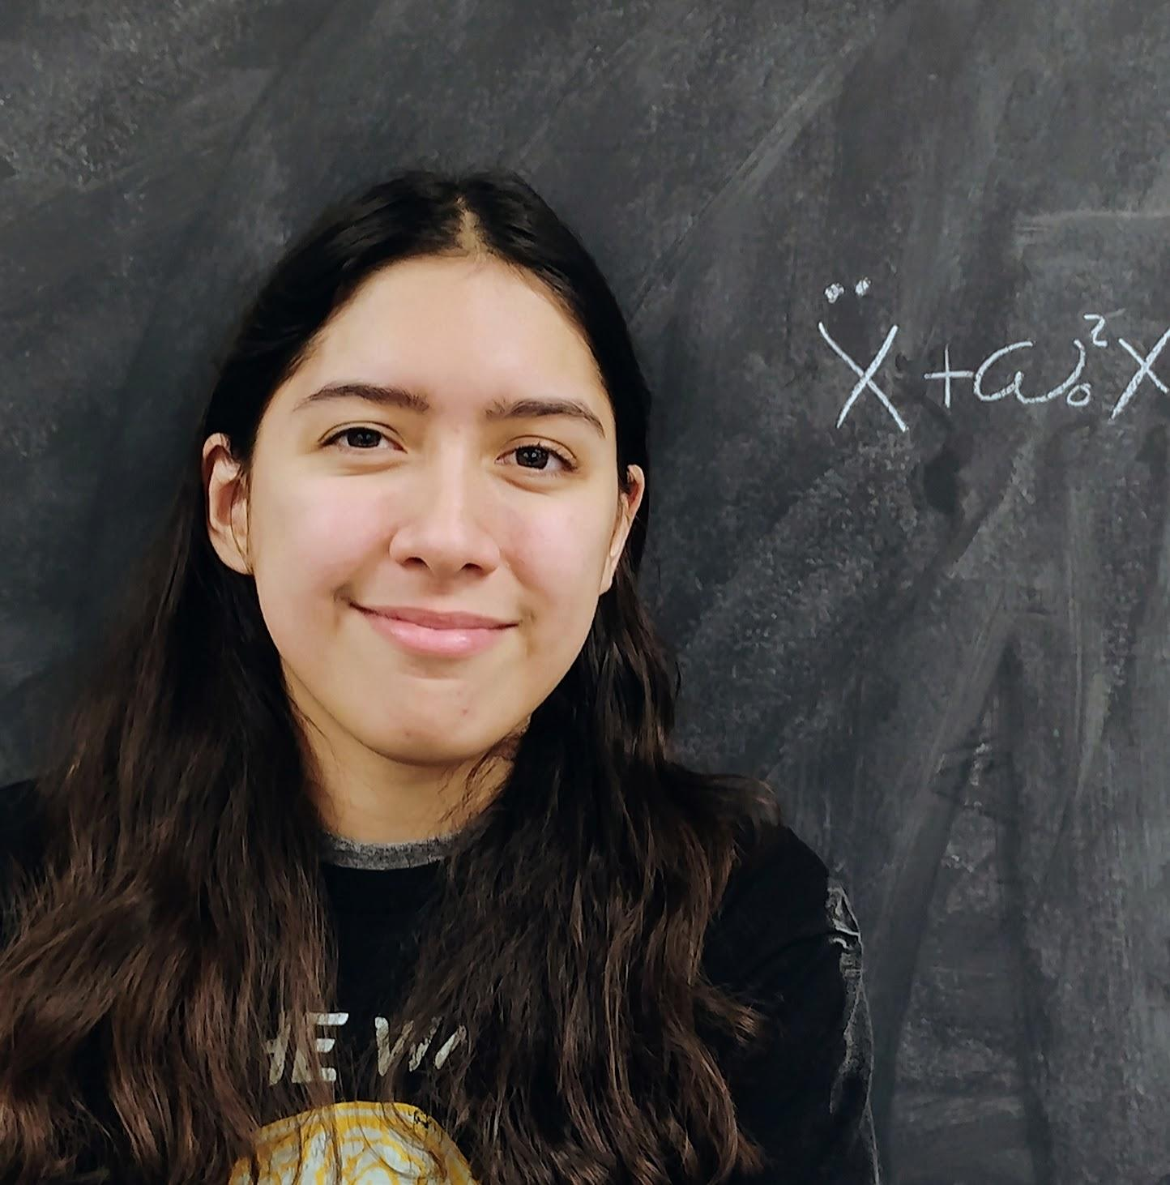
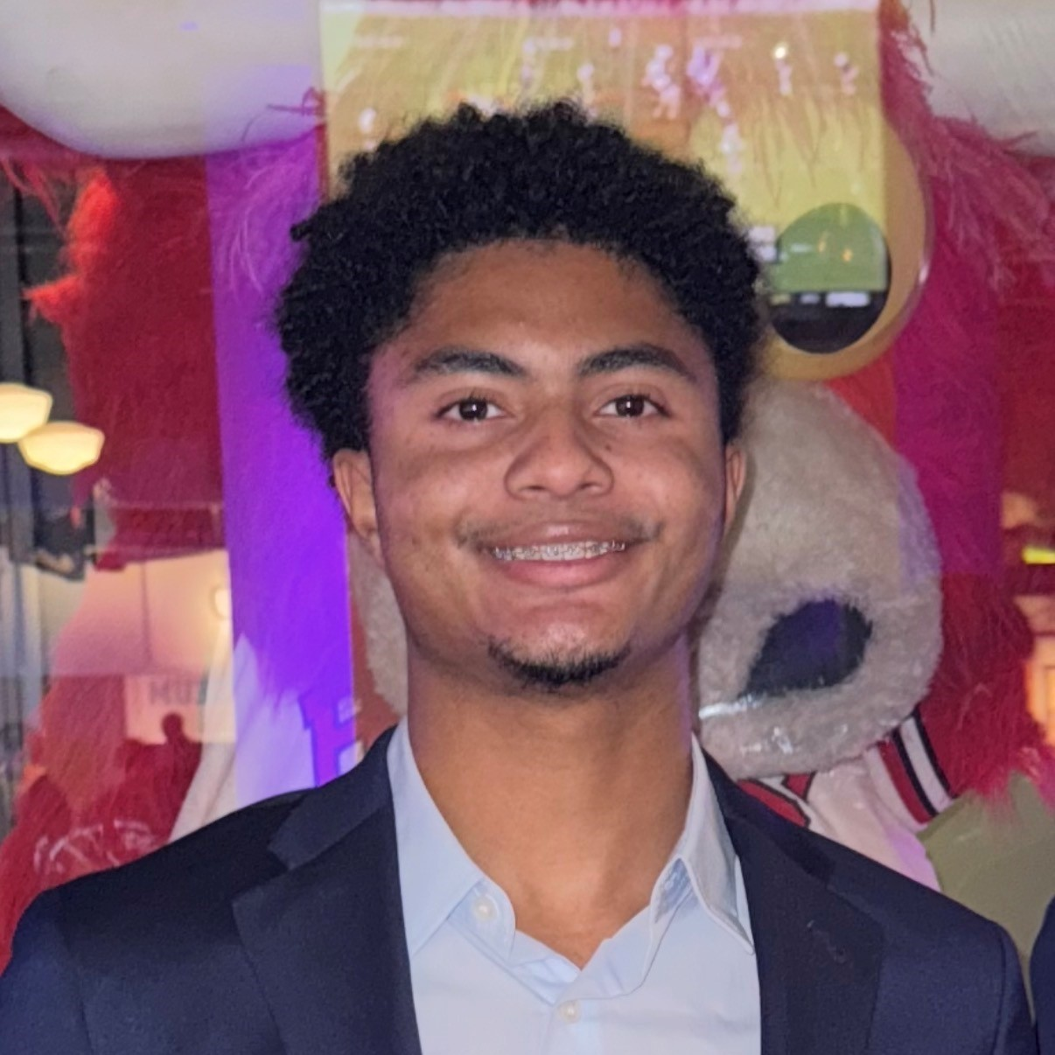

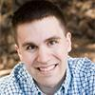


Acknowledgements
Brian Odom
Daniel Lutes
Joel Adhiambo
Haley Randall
Brandon Lofton
Kovachy
Lab
ACME
Tim Kovachy
Sharika Saraf
Xing Fan
The study resulting in this presentation was assisted by a grant from the Undergraduate Research Grant Program which is administered by Northwestern University's Office of Undergraduate Research. However, the conclusions, opinions, and other statements in this presentation are the author's and not necessarily those of the sponsoring institution.

Slide 21
Supplemental Slides:

Slide 22
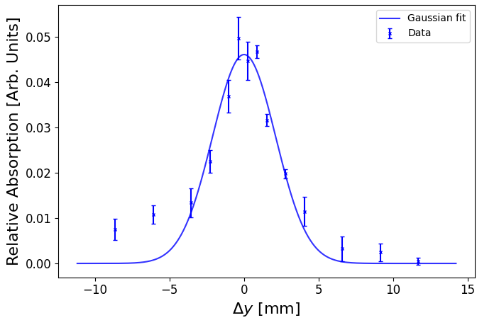
Divergence
𝛳
1/e width
Notes:
Cut

Slide 23

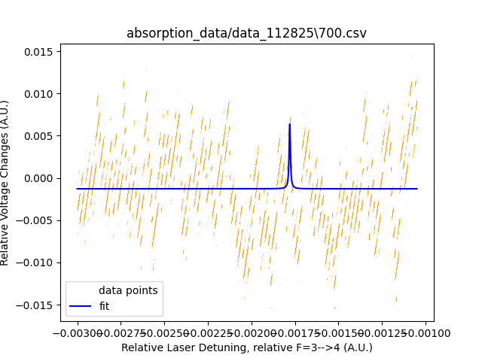
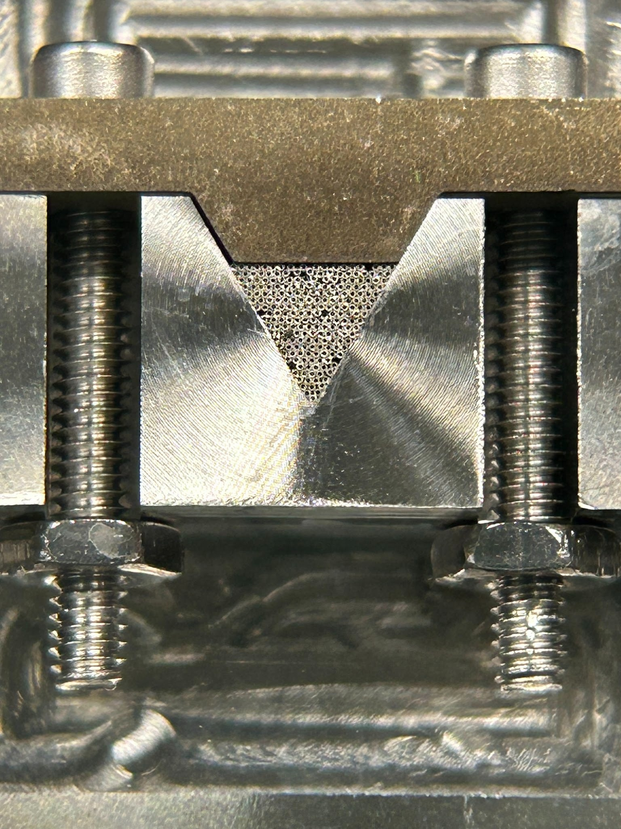

Slide 24
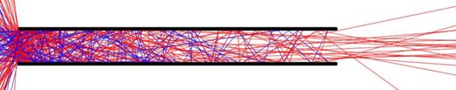
Rb-Ar
Smth about Ar and Rb being same divergence….
λ = k_B T/(sqrt[2]pi*d^2*P)
Prb << Par
λrb/λar ~ d_ar^2/d_rb^2
~½
Want λ ~> L > d to get aspect ratio like divergence.
-> λrb will exit ideal regime of divergence set by aspect ratio before λar does
Notes:
Cut

Slide 25
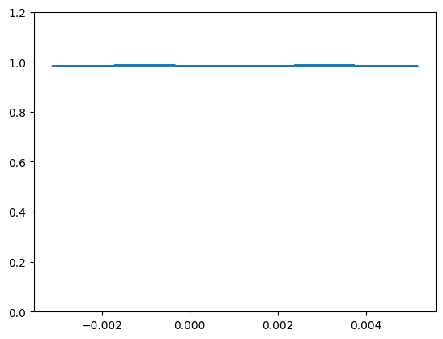
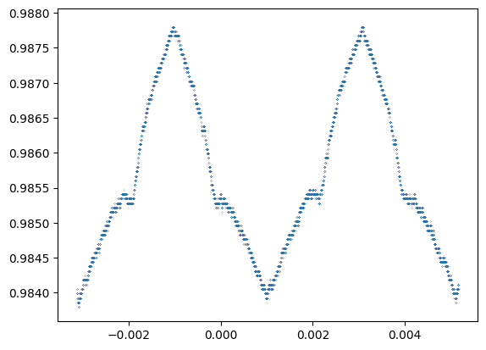
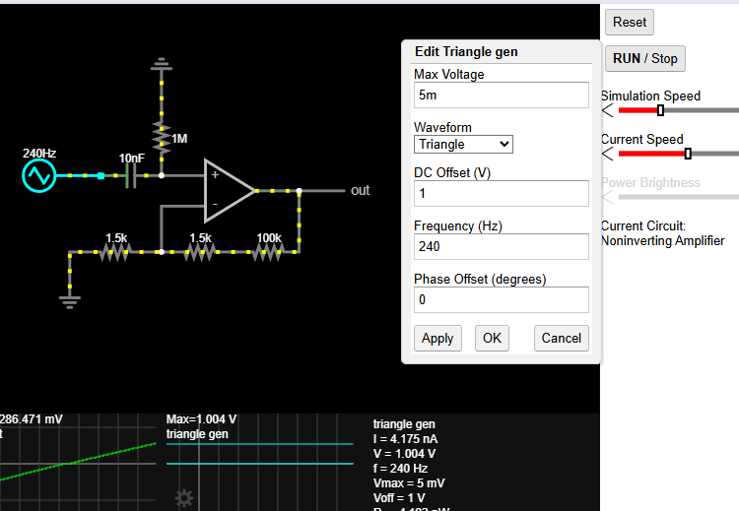
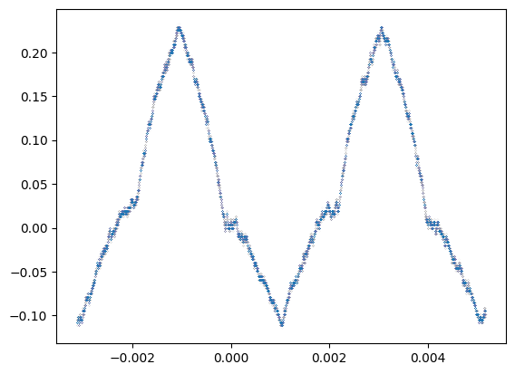
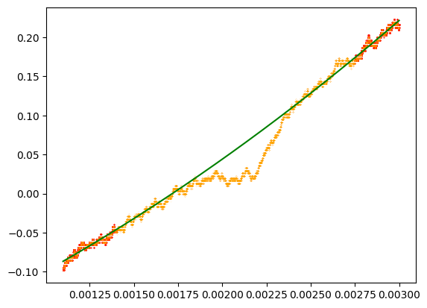
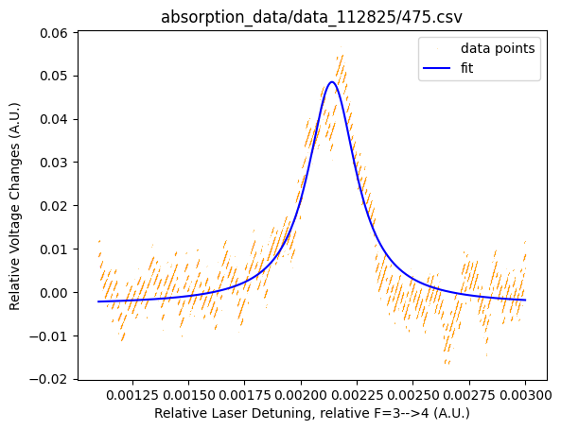

Slide 26
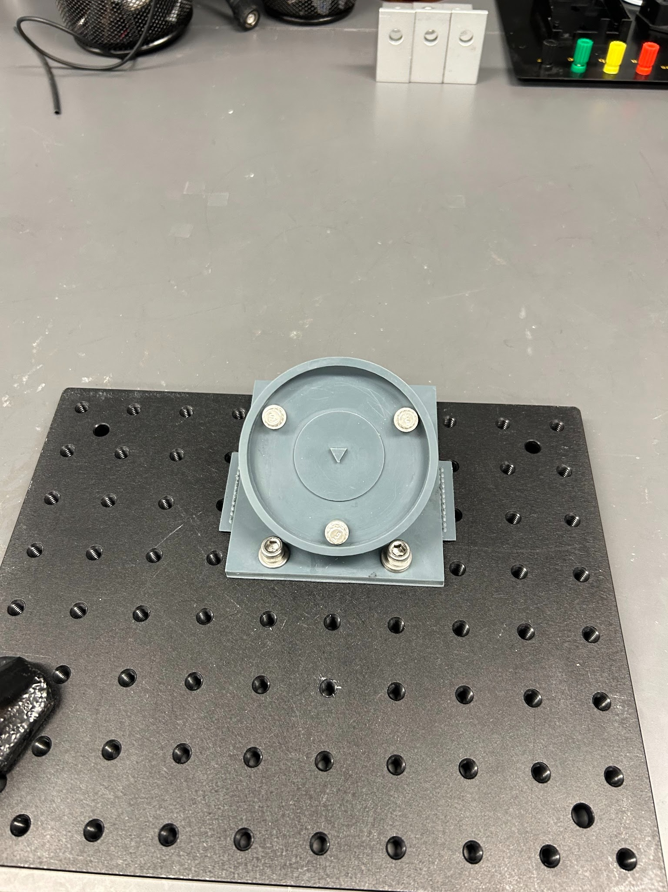
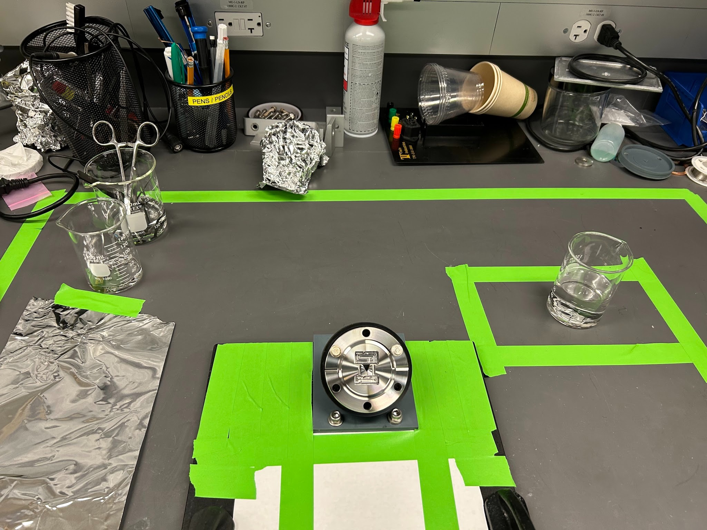
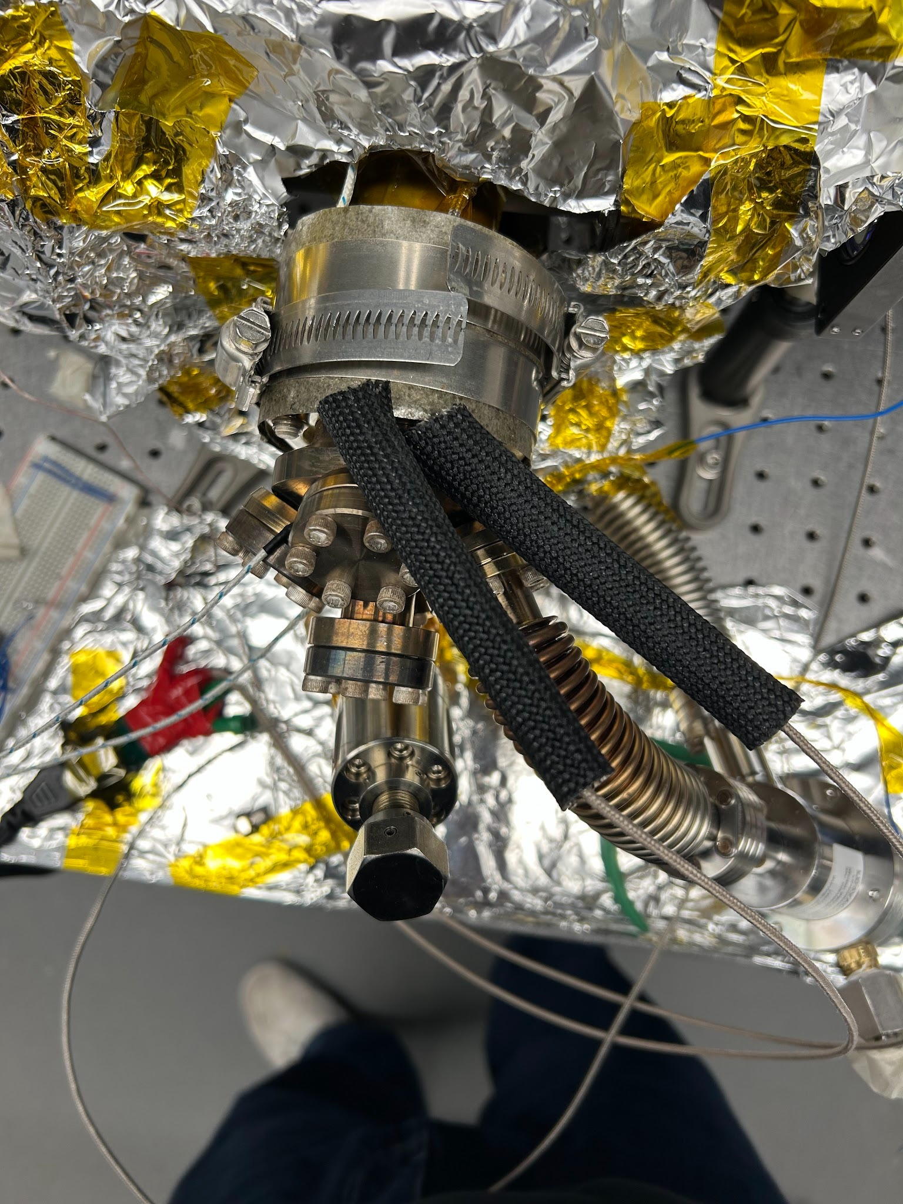

Slide 27
Current Doped Cryogenic Crystals

Slide 28
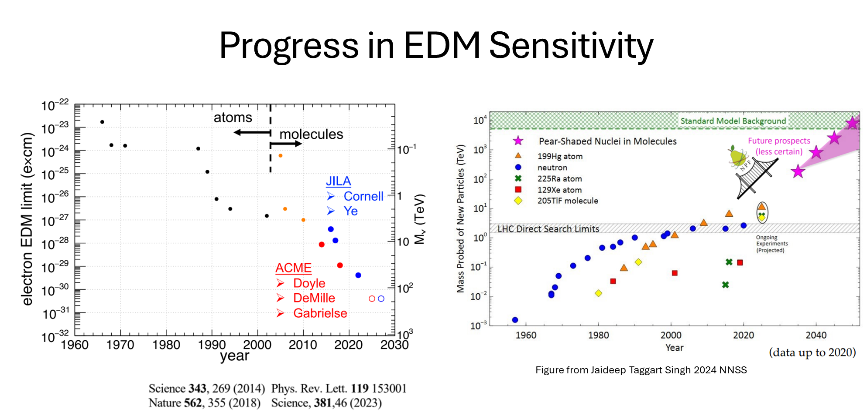

Slide 29
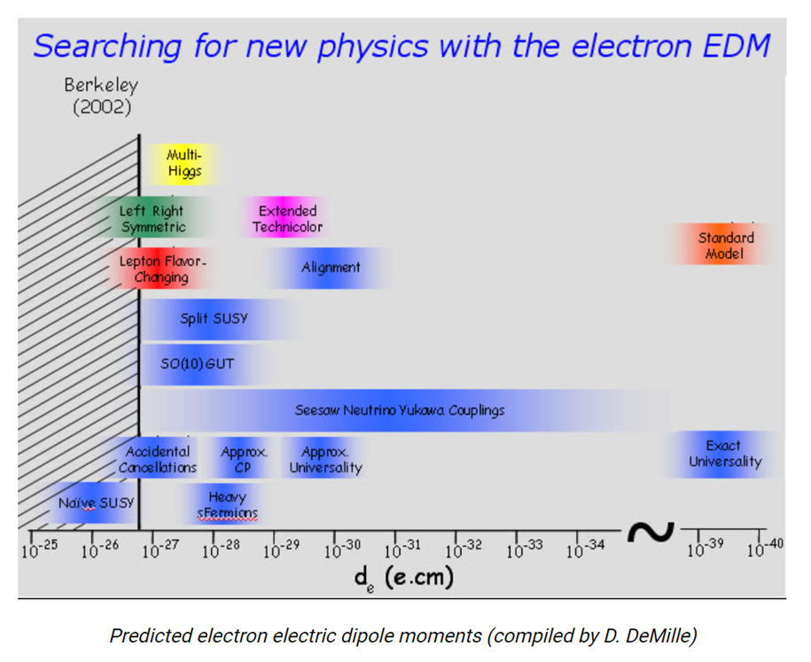
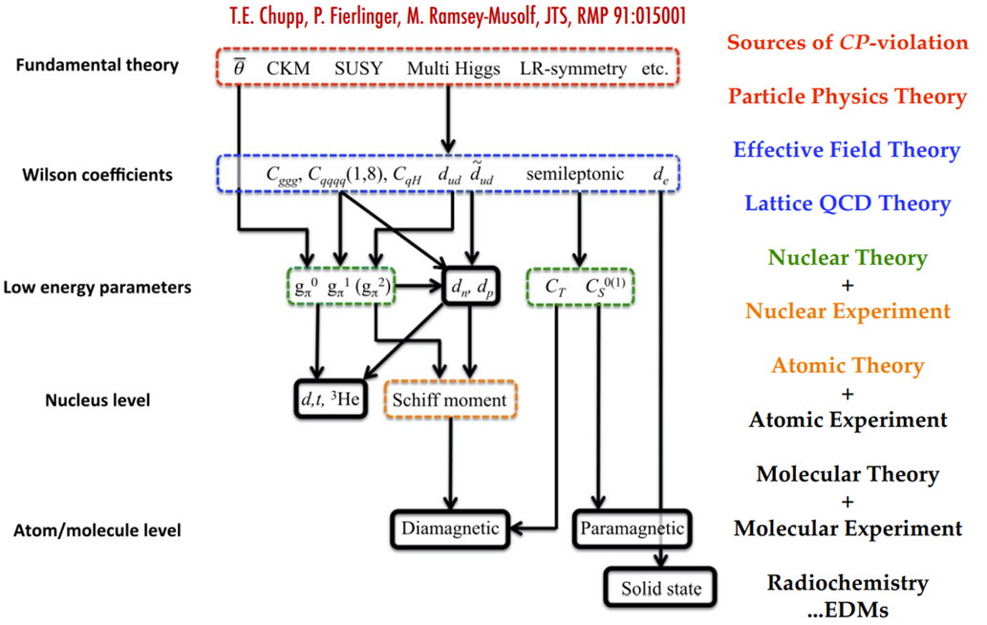

Slide 30



